Slide 1

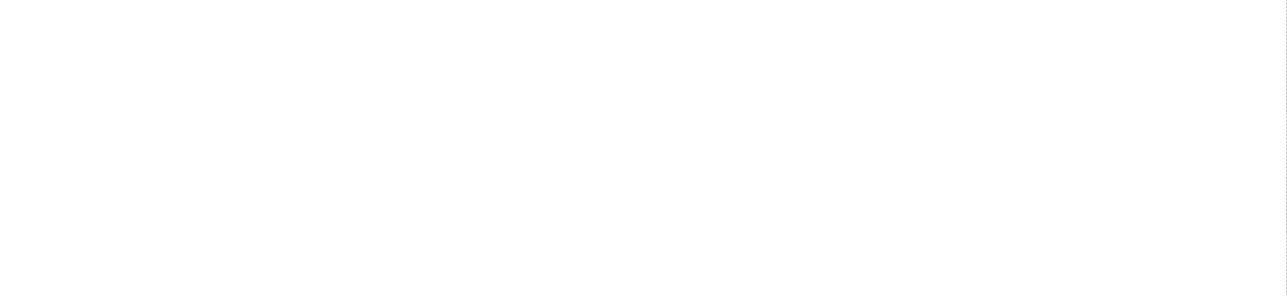
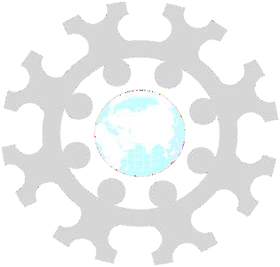
INSTITUTE: UIE (AIT-CSE)
CSS21: B.E. CSE (H) with specialization in Artificial Intelligence & Machine Learning
Advanced Machine Learning (20CSF-349)
Chapter 2.2.1: Support Vector Machine (SVM)
Lecture 19 & 20:Concept of hyperplane in 2D and 3D &
Maximal Margin Classifier
By: Mr. Siddharth Kumar
DISCOVER . LEARN . EMPOWER

Slide 2
Advanced Machine Learning
Course Outcome
CO | Title
1 | Have a good understanding of the fundamental issues and challenges of machine learning: data, model selection, model complexity, etc.
2 | Appreciate the underlying mathematical relationships within and across Machine Learning algorithms and the paradigms of supervised and un-supervised learning
3 | Design and implement various machine learning algorithms in a range of real-world applications.
4 | Design and evaluate intelligent expert models for perception and prediction using machine learning algorithms
5 | Analyze and make use of machine learning algorithms-based applications using performance

Slide 3
Support Vector Machine
Support Vector Machine (SVM) is a supervised classification method that separates the data using hyper planes.
The objective of the support vector machine algorithm is to find a hyper plane in an N-dimensional space(N: the number of features) that distinctly classifies the data points.
The goal of the SVM algorithm is to create the best line or decision boundary that can segregate n-dimensional space into classes so that we can easily put the new data point in the correct category in the future. This best decision boundary is called a hyperplane.
SVM chooses the extreme points/vectors that help in creating the hyperplane. These extreme cases are called as support vectors, and hence algorithm is termed as Support Vector Machine. Consider the below diagram in which there are two different categories that are classified using a decision boundary or hyperplane:

Slide 4
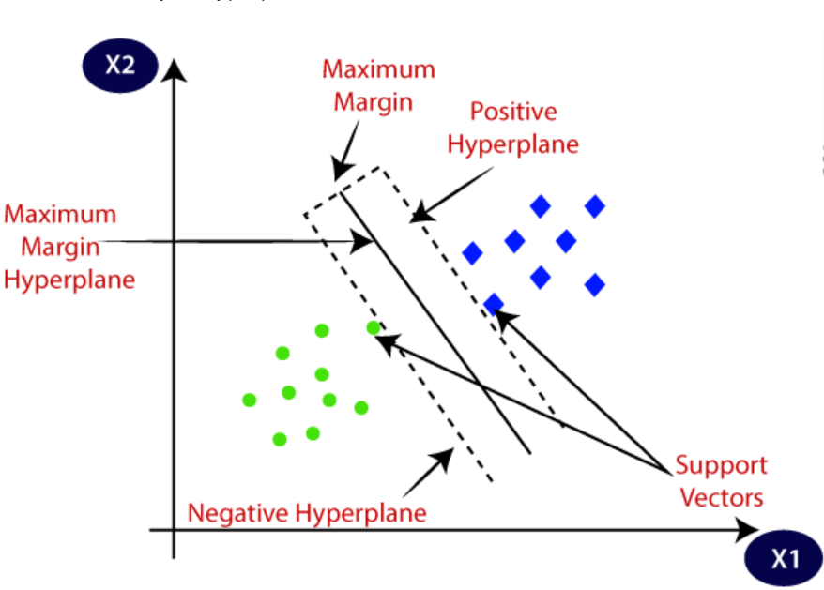
Example: SVM can be understood with the example that we have used in the KNN classifier. Suppose we see a strange cat that also has some features of dogs, so if we want a model that can accurately identify whether it is a cat or dog, so such a model can be created by using the SVM algorithm.
We will first train our model with lots of images of cats and dogs so that it can learn about different features of cats and dogs, and then we test it with this strange creature. So as support vector creates a decision boundary between these two data (cat and dog) and choose extreme cases (support vectors), it will see the extreme case of cat and dog. On the basis of the support vectors, it will classify it as a cat. Consider the below diagram:

Slide 5
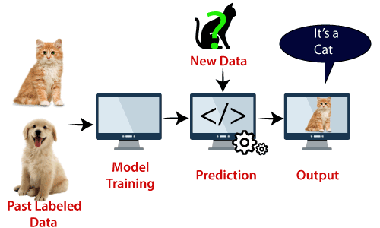
SVM algorithm can be used for Face detection, image classification, text categorization, etc.
Types of SVM
SVM can be of two types:
Linear SVM
Non-linear SVM

Slide 6
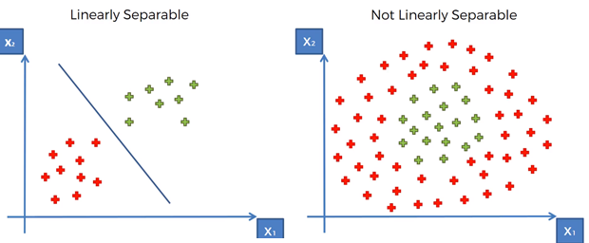
Linear SVM: Linear SVM is used for linearly separable data, which means if a dataset can be classified into two classes by using a single straight line, then such data is termed as linearly separable data, and classifier is used called as Linear SVM classifier.
Non-linear SVM: Non-Linear SVM is used for non-linearly separated data, which means if a dataset cannot be classified by using a straight line, then such data is termed as non-linear data and classifier used is called as Non-linear SVM classifier.
Note: When we can easily separate data with hyperplane by drawing a straight line is Linear SVM. When we cannot separate data with a straight line we use Non – Linear SVM.

Slide 7
Concept of Hyperplane in 2D and 3D
Hyperplane: There can be multiple lines/decision boundaries to segregate the classes in n-dimensional space, but we need to find out the best decision boundary that helps to classify the data points. This best boundary is known as the hyperplane of SVM.
The dimensions of the hyperplane depend on the features present in the dataset, which means if there are 2 features, then hyperplane will be a straight line. And if there are 3 features, then hyperplane will be a 2-dimension plane.
We always create a hyperplane that has a maximum margin, which means the maximum distance between the data points.
Support Vectors: The data points or vectors that are the closest to the hyperplane and which affect the position of the hyperplane are termed as Support Vector. Since these vectors support the hyperplane, hence called a Support vector.

Slide 8
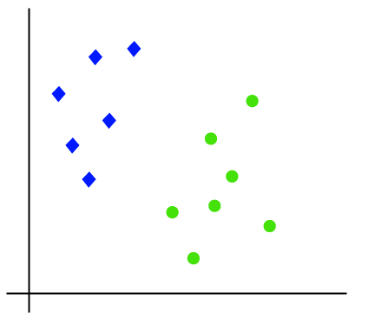
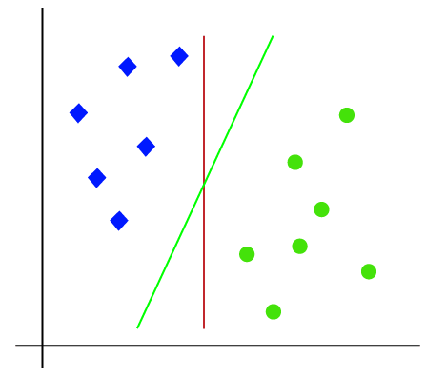
The working of the SVM algorithm can be understood by using an example. Suppose we have a dataset that has two tags (green and blue), and the dataset has two features x1 and x2. We want a classifier that can classify the pair(x1, x2) of coordinates in either green or blue. Consider the below image:
So as it is 2-d space so by just using a straight line, we can easily separate these two classes. But there can be multiple lines that can separate these classes. Consider the above image:

Slide 9
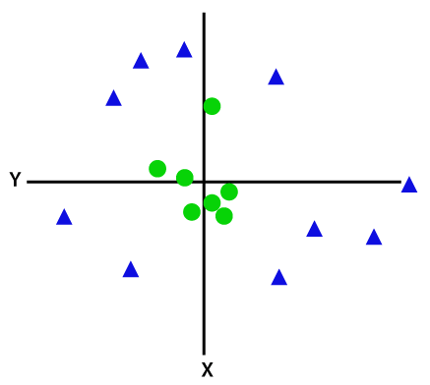
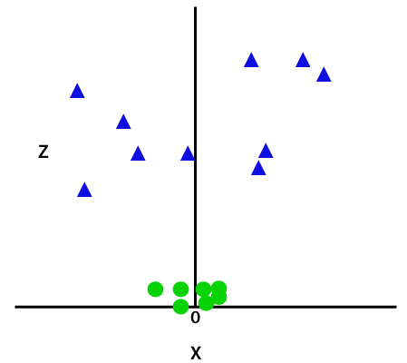
If data is linearly arranged, then we can separate it by using a straight line, but for non-linear data, we cannot draw a single straight line. Consider the below image:
So to separate these data points, we need to add one more dimension. For linear data, we have used two dimensions x and y, so for non-linear data, we will add a third dimension z. It can be calculated as:
By adding the third dimension, the sample space will become as below image:
z=x² +y²

Slide 10
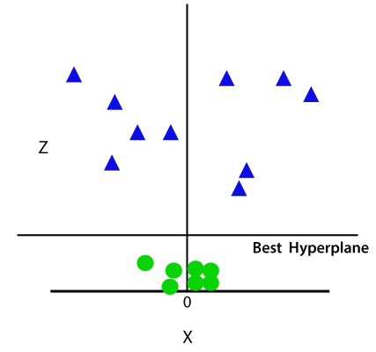
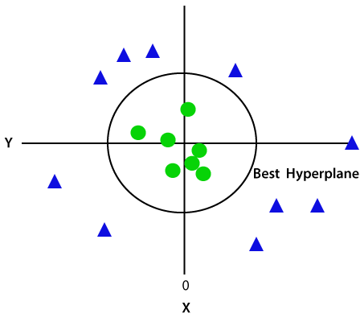
So now, SVM will divide the datasets into classes in the following way. Consider the below image:
Since we are in 3-d Space, hence it is looking like a plane parallel to the x-axis. If we convert it in 2d space with z=1, then it will become as:
Hence we get a circumference of radius 1 in case of non-linear data.

Slide 11
Maximal Margin Classifier
The Maximal-Margin Classifier is a hypothetical classifier that best explains how SVM works in practice.
The numeric input variables (x) in your data (the columns) form an n-dimensional space. For example, if you had two input variables, this would form a two-dimensional space.
A hyperplane is a line that splits the input variable space. In SVM, a hyperplane is selected to best separate the points in the input variable space by their class, either class 0 or class 1. In two-dimensions you can visualize this as a line and let’s assume that all of our input points can be completely separated by this line.
For example:
B0 + (B1 * X1) + (B2 * X2) = 0
Where the coefficients (B1 and B2) that determine the slope of the line and the intercept (B0) are found by the learning algorithm, and X1 and X2 are the two input variables.
You can make classifications using this line. By plugging in input values into the line equation, you can calculate whether a new point is above or below the line.

Slide 12
Above the line, the equation returns a value greater than 0 and the point belongs to the first class (class 0).
Below the line, the equation returns a value less than 0 and the point belongs to the second class (class 1).
A value close to the line returns a value close to zero and the point may be difficult to classify.
If the magnitude of the value is large, the model may have more confidence in the prediction.
The distance between the line and the closest data points is referred to as the margin. The best or optimal line that can separate the two classes is the line that as the largest margin. This is called the Maximal-Margin hyperplane.
The margin is calculated as the perpendicular distance from the line to only the closest points. Only these points are relevant in defining the line and in the construction of the classifier. These points are called the support vectors. They support or define the hyperplane.
The hyperplane is learned from training data using an optimization procedure that maximizes the margin.

Slide 13
References
T1: Mitchell T.M., Machine Learning, McGraw Hill (1997).
T2: Andreas C. Miller, Sarah Guido, Introduction to Machine Learning with Python, O’REILLY (2001).
Notes:
Introduction to Cyber Security (simplilearn.com)

Slide 14

THANK YOU

